Slide 1
THE POTENTIAL FOR INVESTMENTS IN THE SERVICE SECTOR
Nangula Nelulu Uaandja
October 2021
Economic Association of Namibia

Slide 2
THE IMPORTANCE OF SERVICES ECONOMIC GROWTH

Slide 3
“The best way to predict the future is to invent it.”
– Alan Kay

Slide 4
The service sector is a crucial component of every country’s economy, and it has been identified as a sector with the capability to become a significant driver of sustained growth in Africa.
The world economy is increasingly characterized as a service economy. This is primarily due to the increasing importance and share of the service sector in the economies of most developed and developing countries.
The growth of the service sector has long been considered as an indicator of a country’s economic progress. Economic history tells us that all developing nations have invariably experienced a shift from agriculture to industry and then to the service sector as the mainstay of the economy.
The service sector is currently one of the fastest growing sector in the world. It accounts for a significant proportion of gross domestic product in most countries and makes significant contribution to the share of total employment
SERVICE SECTORS & ECONOMIC GROWTH

Slide 5
SERVICE SECTORS & ECONOMIC GROWTH
A productive service sector is known to strengthen the performance of other sectors in the economy such as manufacturing . This is because the sector enables and facilitates the functioning of most sectors (manufacturing, industrial sector, etc), as most of these sectors rely majorly on the service sector to supply needed functions such as banking, accountancy, information, and technology.
The service sector also influences the development of businesses by increasing productivity and value added. This is attainable by using highly educated and experienced workers with particular cognitive skills, thus increasing the business productivity.
Many services have emerged as promising tradable services for developing countries, particularly with the development of telecommunications and information and communications technology (ICT) services. In addition, efficient services are catalysts for the expansion of regional and global value chains.

Slide 6
SERVICE SECTORS & ECONOMIC GROWTH
Service Industry | Direct GDP Multipliers | Direct Labour Multipliers
Wholesale and retail trade; repairs | 0.58 | 1.06
Hotels and restaurants | 0.40 | 1.33
Transport | 0.38 | 0.83
Communication | 0.58 | 0.77
Finance and insurance | 0.71 | 0.81
Real estate, own | 1.00 | 3.45
Market Real Estate & Business services | 0.80 | 4.75
Other private services | 0.80 | 6.64
Health, Education, Publ Admin | 0.63 | 5.53
Economic Multiplier impact of service sectors in Namibia.
Notes:
Source : PwC multiplier table for MOF_BON

Slide 7
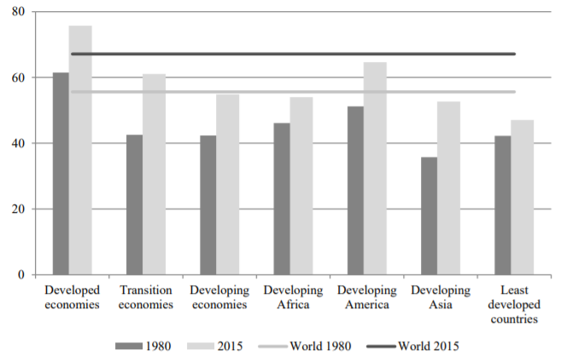
SERVICES & GDP
Share of services in gross domestic product by income level and region, 1980 and 2015
Notes:
Source: UNCTADstat

Slide 8
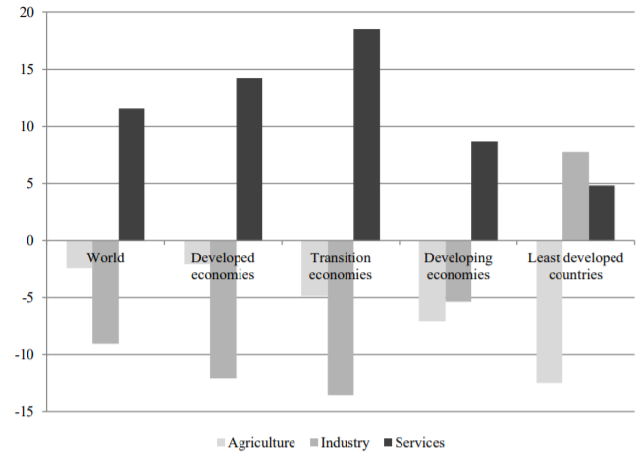
SERVICES & GDP
Share of economic sectors in gross domestic product by income level, change in 1980–2015
Notes:
Source: UNCTADstat

Slide 9
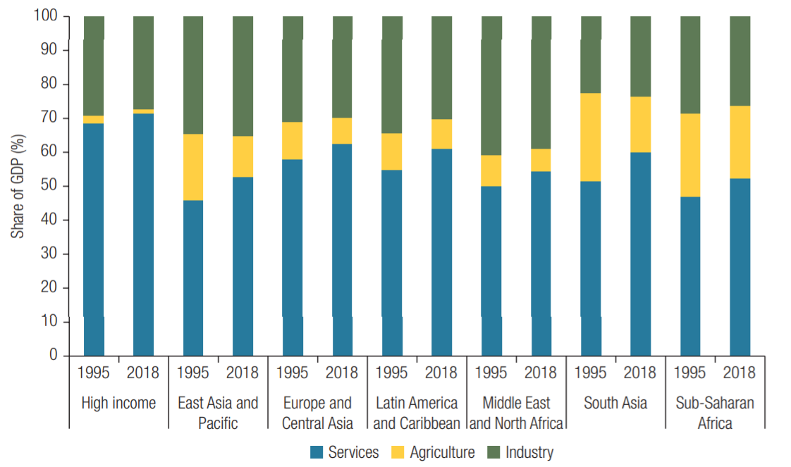
SERVICES & GDP
Share of economic sectors in gross domestic product
“Nayyar, Gaurav; Hallward-Driemeier, Mary; Davies, Elwyn. 2021. At Your Service? : The Promise of Services-Led Development. Washington, DC: World Bank. © World Bank. https://openknowledge.worldbank.org/handle/10986/35599 License: CC BY 3.0 IGO.”
Notes:
Source: World Development Indicators database (World Bank)

Slide 10
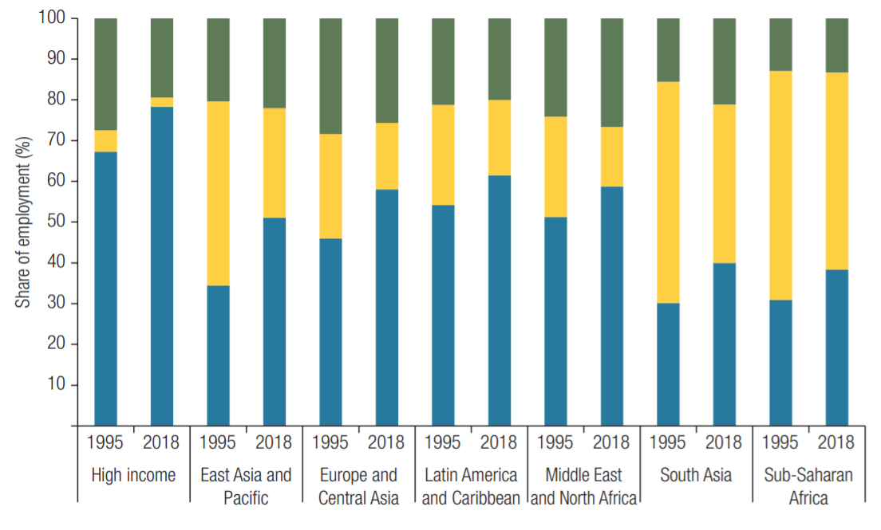
SERVICES & Employment
Share of economic sectors in employment
“Nayyar, Gaurav; Hallward-Driemeier, Mary; Davies, Elwyn. 2021. At Your Service? : The Promise of Services-Led Development. Washington, DC: World Bank. © World Bank. https://openknowledge.worldbank.org/handle/10986/35599 License: CC BY 3.0 IGO.”
Notes:
Source: World Development Indicators database (World Bank)

Slide 11
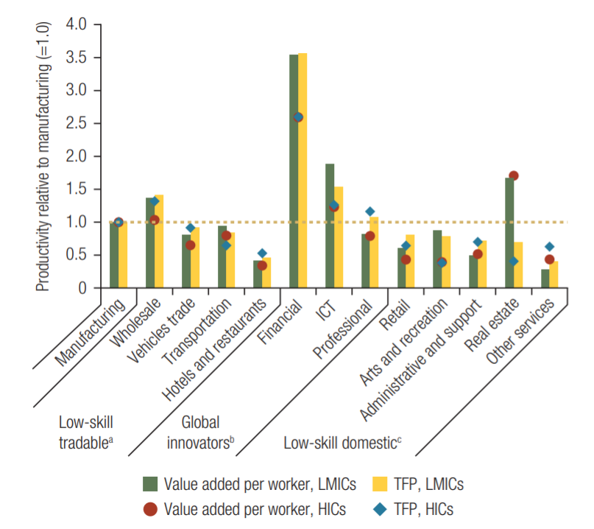
SERVICES & Productivity
Productivity of service sectors relative to manufacturing
“Nayyar, Gaurav; Hallward-Driemeier, Mary; Davies, Elwyn. 2021. At Your Service? : The Promise of Services-Led Development. Washington, DC: World Bank. © World Bank. https://openknowledge.worldbank.org/handle/10986/35599 License: CC BY 3.0 IGO.”
Notes:
Source: Calculations based on administrative firm-level data, supplemented with aggregated data from the Organisation for Economic Co-operation and Development (OECD) and the European Union’s statistical office, Eurostat

Slide 12
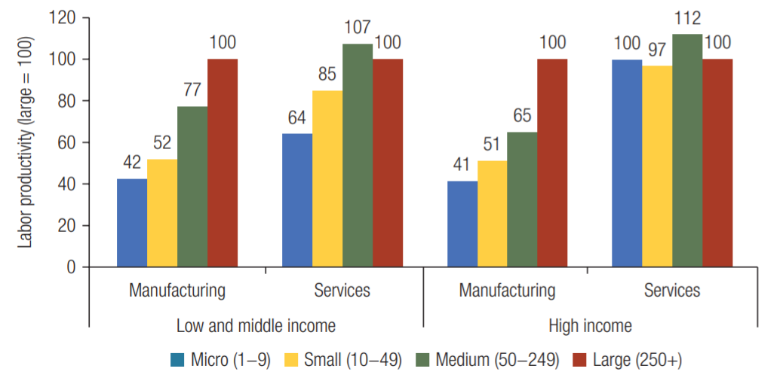
SERVICES & Productivity
Small firms better compete with large ones in service than manufacturing
“Nayyar, Gaurav; Hallward-Driemeier, Mary; Davies, Elwyn. 2021. At Your Service? : The Promise of Services-Led Development. Washington, DC: World Bank. © World Bank. https://openknowledge.worldbank.org/handle/10986/35599 License: CC BY 3.0 IGO.”
Notes:
Sources: Calculations using administrative firm-level data, supplemented with aggregated data from the Organisation for Economic Co-operation and Development (OECD) and the European Union’s statistical office, Eurostat.

Slide 13
KNOW HOW
It is about having to know how to do different complementary things

Slide 14
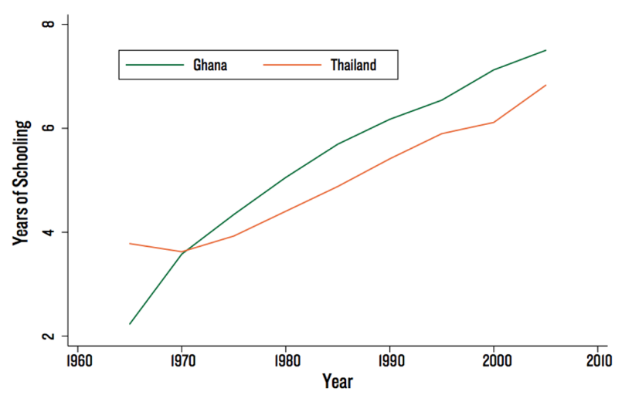
HUMAN CAPITAL STORY
Years of schooling of Thailand and Ghana as a function of time

Slide 15
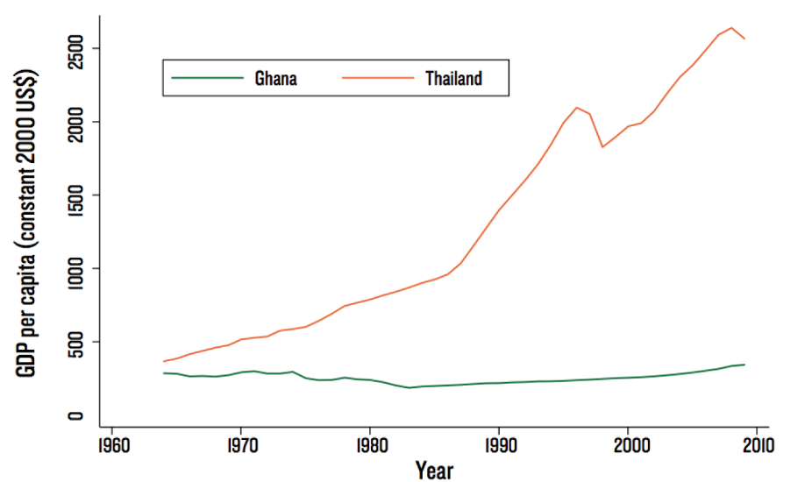
DIVERGENCE
Evolution of the GDP per capita of Thailand and Ghana as a function of time

Slide 16
THE SCRABBLE THEORY OF ECONOMIC DEVELOPMENT
Accordingly, economic development involves finding out which products can be produced with a place's current capabilities – what words it can write with the letters it currently has. It also involves finding out how new letters can be acquired.

Slide 17
With 10 letter,
You can make 595 words, of 10 letters…

Slide 18
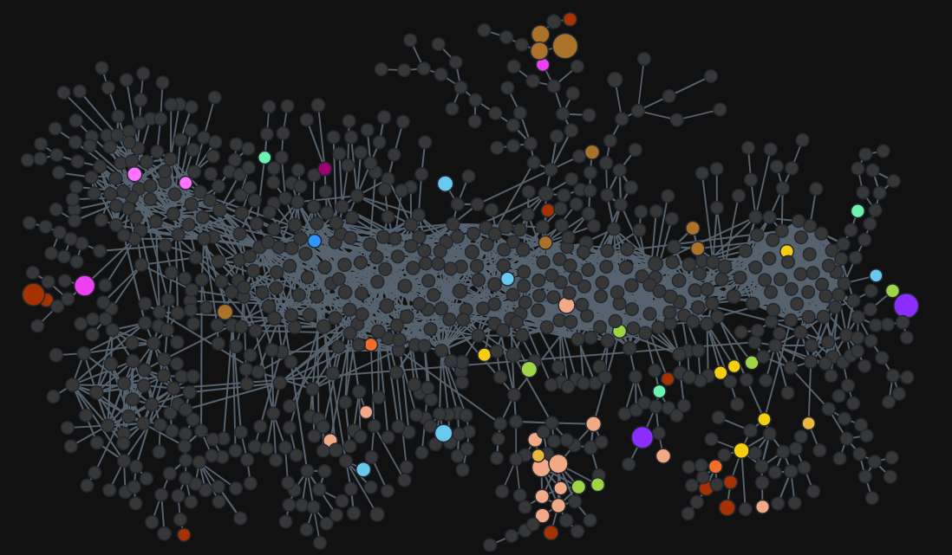
THEORY OF ECONOMIC COMPLEXITY
Notes:
TREES

Slide 19
HOW COUNTRIES WITH SMALLER POPULATIONS LEVERAGED SERVICES FOR ECONOMIC GROWTH

Slide 20
MAURITIUS
In Mauritius, the services sector, contributes on average 68.5% of GDP, compared to 27.4% for the secondary sector and 4.1% by the primary sector which consists mainly of agricultural activities. The tertiary sector grew by 5.7% in 2008.
The service industry continues to be a major engine of growth in Mauritius which is driven in part by the rapid changes in information technology and telecommunications that support service delivery.
The government strategy centred on further diversifying the economic base in order to propel the economy onto higher levels of sustainable development alongside the consolidation, modernisation and expansion of the existing sectors has proved beneficial over the years.
The economy seems to be driven by the services sectors, especially activities in
"Hotels and Restaurants", "Transport storage and communications", "Real estate,
renting and business activities" and "Financial intermediation".
Notes:
Source : Services Sector Development: A Key to Poverty Alleviation in Mauritius , Tandrayen-Ragoonbur Verena, Ragoobur Vishal and Poonoosamy Ken, December 2009

Slide 21
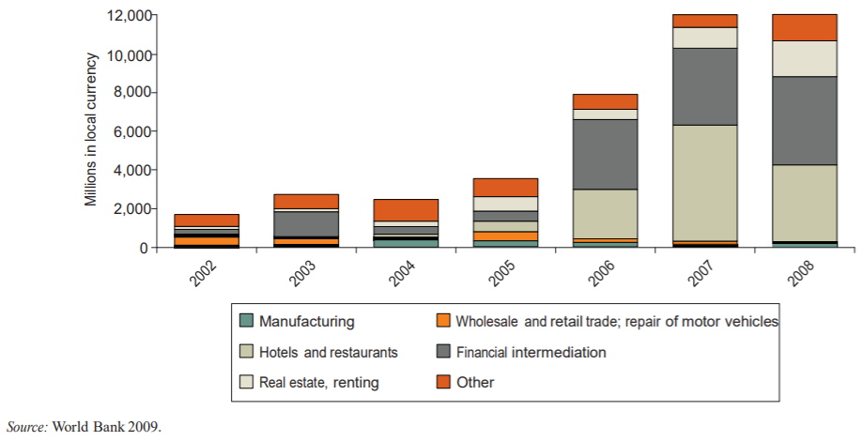
SERVICES & FDI
FDI Inflows to Mauritius
Notes:
Source:
World Bank. 2009. Mauritius Investment Climate Assessment. Washington, DC.

Slide 22
SINGAPORE
Singapore continues to make the transition from a manufacturing-based to a service-based economy.
The government highlighted a focus in technology and education to be the new wave of economic gain. In addition, they identified financial services as a key area in which Singapore could diversify and attract new growth. During this time, the government invested heavily in its budding financial services industry.
The financial services industry has enjoyed stable growth due to Singapore’s pro-business environment and political stability. Home to over 200 banks and a regional hub of choice for many global financial services firms, Singapore’s financial services marketplace facilitates the transfer of knowledge, processes, technology and skills between global, regional and domestic markets.
Notes:
Source : Services Sector Development: A Key to Poverty Alleviation in Mauritius , Tandrayen-Ragoonbur Verena, Ragoobur Vishal and Poonoosamy Ken, December 2009

Slide 23
WHAT DOES THIS MEAN FOR NAMIBIA

Slide 24
DIVERSIFICATION SECTORS

Slide 25
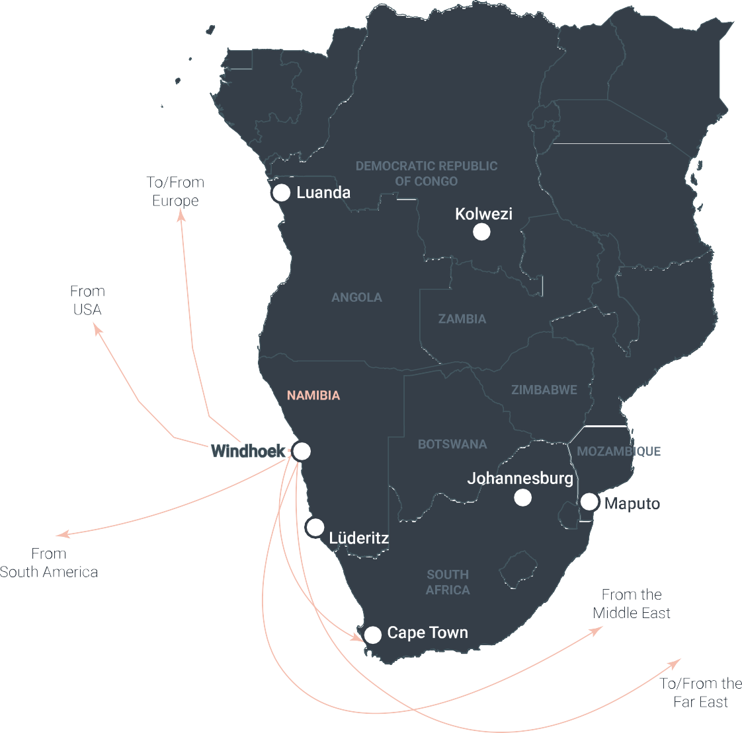
NAMIBIA GATEWAY TO SADC REGION (MARKET ACCESS)
Strategic Geographic Location
(road, rail, sea, air)
Transport Corridor Network
Angola (3-5 days)
Botswana (2 days)
DRC (5-6 days)
Malawi (5-6 days) South Africa (2 days) Zambia (3-4 days)
Europe, East Asia, North America, Middle East
MACS, Maersk, Ocean Africa Containers
Botswana
Zambia
Zimbabwe

Slide 26
SUPPORT FOR SERVICE PROVISION
Infrastructure services are essential to the development of other service sectors, including tourism, distribution (wholesale, retail), information and communications technology (ICT) services, and business process outsourcing services.
For infrastructure services to contribute successfully to the economic and social development of Namibia, the institutional and regulatory environment must be supportive.

Slide 27
TYPES OF SERVICE OPPORTUNITIES IN NAMIBIA
Business Consulting
Digital Nomads
IT service provision
Marketing
Virtual Assistant Service
Research Service
Traditional services

Slide 28
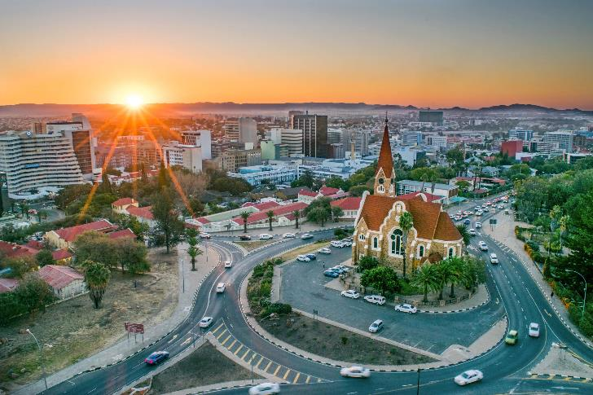
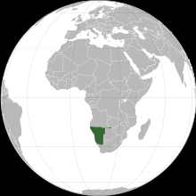
Namibia = USD 4,175.18 GDP per capita
Notes:
Current GDP

Slide 29
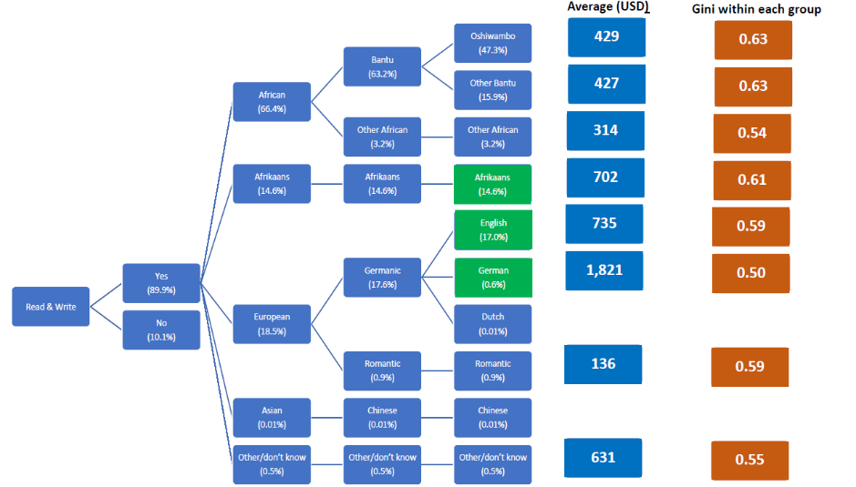
Coefficients within Groups: Namibia
Notes:
The income disparity is not only between countries…. Within the same country… same exchange rates, same interest rates same tax regime, etc.… we have difference on productivity per worker of about a factor of 10! (
Explain Slide)

Slide 30
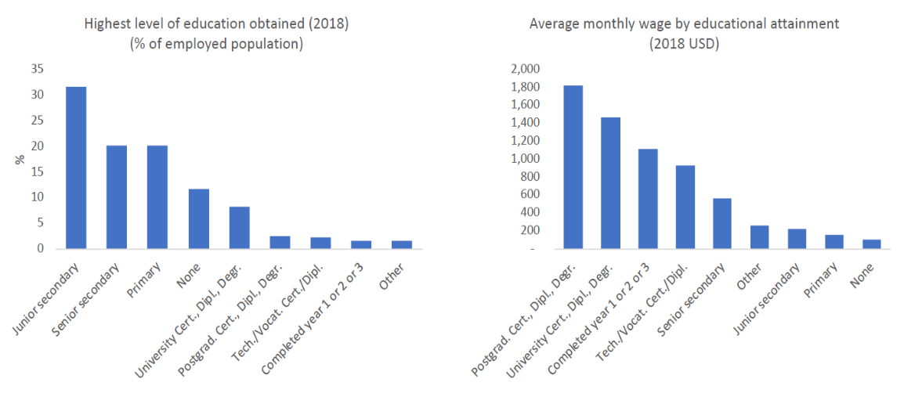
There are very large differences in INCOME by EDUCATION level

Slide 31
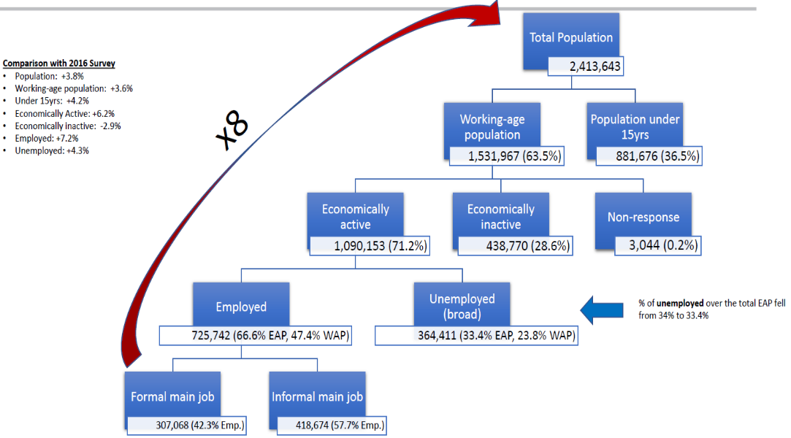
Very few people work in the formal sector

Slide 32
Very few people work in formal firms

Slide 33
THE ROLE OF NIPDB

Slide 34
THE MACROECONOMIC FORMULA
What levers can we pull to grow the economy?
GDP = C + I + G + (X-M)
❌
❌
GDP Gross Domestic Product
X – M Net exports = Exports – imports
C Consumer spending
I Investments
G Government spending

Slide 35
PRIVATE SECTOR COLLABORATION
The private sector has the greatest potential to create value for both business and society in the area of expanding economic opportunities.
Business activities can create jobs and entrepreneurial opportunities, build human capital and physical infrastructure, generate revenue for Government, and improve competitiveness in the economy.
The private sector has a role to play not only by being a catalyst for economic growth and development, but also by working with Government to implement policy through PPPs.
More needs to be done not only to encourage private sector investment, but also to ensure Government efforts facilitate private sector investments.
Notes:
Private sector - solution to the fiscal limit

Slide 36
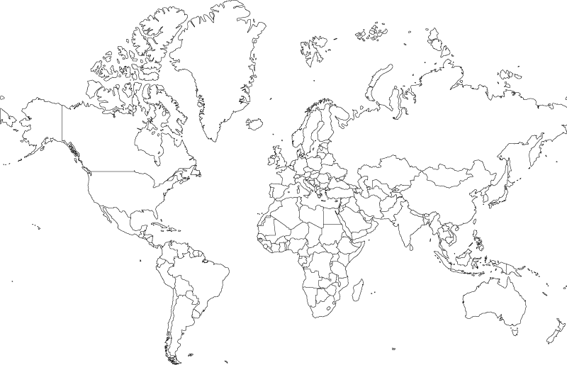
WEF COMPETITIVENESS RANKINGS
Namibia
Botswana
Rwanda
South Africa
1
Overall Competitiveness Ranking
94 | 91 | 100 | 60
41 | 60 | 90 | 83
44 | 66 | 45 | 61
56 | 70 | 36 | 55
94 | 108 | 111 | 69
2
Financial Systems
3
Labour Market
4
Institutions
5
Infrastructure
41 Countries Ranked May 2019
Notes:
Namibia’s attractiveness to the private sector

Slide 37
EASE OF DOING BUSINESS
Singapore 2
Mauritius 13
87
Botswana
104
Namibia
38
Rwanda
South Africa
84
85
Zambia
Ranked out of 191 countries. Source Doing Business
Notes:
Namibia’s attractiveness to the private sector

Slide 38
STAKEHOLDER PERCEPTIONS - THEMATIC GROUPS
Counter-industry pace
Non-committal
Slow decision-making;
Investors to devise own means of getting to the right people.
Both GRN and private sector are non-committal;
Invite investors with urgency but tend not to commit, do not solve problems and remove bottlenecks;
Little to no responsiveness nor commitment.
Politics dictate private sector
People precede process
Blurred lines between politics and private sector;
Little understanding of what private sector is and its role in the economy;
Local businesses are hostile to foreign investors.
No clear processes in place;
No empowerment of people in the process as small decisions are escalated to the highest level;
Investors begging for service or must know someone.
Bureaucratic
Reluctance to import skills
Multiple permits required;
Disjointed process – investors sent from pillar to post.
Visa issuance for skilled foreigners is hindered;
Visa application process is tedious;
Immigration officers only police rather than facilitate investor entry.
Notes:
Source : World Bank

Slide 39
NIPDB - AN ENABLER
1
Identify, develop and assess investment projects for viability and social economic impact, including need for local and public sector participation. Identity new sectors of growth.
Business Policy Reforms, Branding Namibia as a preferred investment destination, Promoting investment projects and promoting effective engagement between the public and private sectors
2
Coordinate and implement programs and policies that will create an enabling ecosystem for MSMEs & Startups
3
Playing an active role in skilling Namibia and getting our workforce 4IR ready as well as promoting enabling labour laws and practices
4
5
Business Facilitation Services including state of the art one stop shop investor services, aftercare and compliance reviews
Supported by Efficient and Effective Internal Processes and Systems
Notes:
How we can improve our attractiveness

Slide 40
Why we exist:
Unlocking opportunities: enabling a better quality of life for all Namibians
What we do: Facilitate trust relationships to attract and retain sustainable investment for private sector-led and inclusive economic growth.
Improve Namibia’s Ease of Doing Business
Targeted support for development and scalability of the MSME sector
Optimize operational efficiency and governance
Unlock Investments to create new, quality sustainable jobs
Ensure that skills are aligned with investment
Improve Namibia’s Competitiveness score
How do we behave: No-one left behind, Accountability, Making a difference, Integrity, Brilliance, Innovation, Agility

Slide 41
CONCLUDING REMARKS

Slide 42
Law and Policy Reform
Ease of Doing Business
One Stop Shop (Physical + E-services)
Namibia Response to Covid-19
CRITICAL SUCCESS FACTORS
Research and Analysis
One Goal Focus.
One team approach
Private Sector Focus (including MSME)
Public Sector Buy-in and Participation
Citizenry Buy-in and Receptiveness (Media Impact)

Slide 43
“One is too small a number to achieve greatness” John C. Maxwell

Slide 44
Thank you
Namibia Investment Promotion & Development Board
Windhoek, Namibia
Email: nangulanelulu.uaandja@nipdb.com

